Slide 1
Cogent basics
with Radi ☺

Slide 2
Table of contents
What is Cogent? Slide 4
Signing in Slide 5
Media Analysis View Slide 9
Left-hand side Slide 10 - 15
Centrefold Slide 16 - 19
Right-hand side Slide 20 - 26

Slide 3




What is Cogent?

Slide 4

No, really, what is it?
Cogent is the platform we use to analyse the media conversation (i.e. to observe & note how the client is being represented in the media discussion) and to monitor the media conversation (i.e. to constantly keep track of the ever-changing landscape and to summarise the articles that are mentioning the client or any topics of interest).
Cogent hosts and facilitates all analysis/monitoring projects. Each client that has chosen Commetric as their service provider has one or several dedicated projects within the Cogent environment.
A project contains the raw data that we need – all articles of interest to the client with their corresponding metadata (date, author, headline, etc.). We can analyse or monitor the coverage efficiently via Cogent’s useful tools.
In season 3 of HBO’s Succession, Greg starts doing Kendal Roy’s media monitoring. You can tell he’s an amateur, because he browses Twitter by hand and he even says “the internet is big and I couldn’t read at all” Well… we can.
Truth is, Cogent used to be Excel. Thanks to the development’s team incredible efforts, it transformed into the beast it is today that helps us do impossible things.

Slide 5
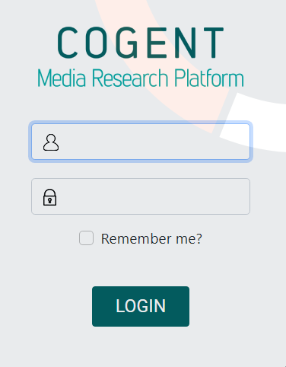
Signing in
https://cogent.commetric.com/
It’s a good idea to bookmark the link as you wouldn’t be able to find the platform just by googling.
I would advise you to log in to Cogent and follow along.

Slide 6

Once you log in to Cogent, you will see the list of My Projects i.e. the projects that you will be working on. For a project to appear within the list of your projects, you have to be assigned as a user – this should be done by your PM.
You can mark a project as a Favourite by clicking on the star sign next to its ID. You can see all of your Favourite projects in the corresponding menu.
Each project has the following characteristics:
Unique ID which helps you locate the project within the Cogent environment.
Name
Type – the project is either a media analysis one (MA; the coverage is analysed) or a media monitoring one (Mon; the coverage is summarised).
Project Group – each project belongs to a larger project group; some clients require the tracking of several business entities and/or topical discussions – all of these projects will fall under the same project group. For example, Centrica is a company that owns several brands, including Centrica, British Gas, Bord Gais etc. The client wants us to analyse coverage about all of them, so the Centrica project, the British Gas project and the Bord Gais project are all part of the Centrica project group.
Manager
Articles – the number of all articles that are safe-housed in that project since its creation.
Processed articles – articles that have been analysed.
Remaining articles – articles that are yet to be analysed.
Progress – ratio between processed and remaining articles.

Slide 7




Where do all the articles come from?
You might be wondering how the media coverage actually reaches Cogent. We source coverage from a variety of aggregators, including Signal, Opoint, Newsedge, Factiva & others.
Opoint, Newsedge and Factiva are used in our work with direct clients. The data is fed to Cogent via Boolean searches. Once established, the whole process becomes pretty much automatic, facilitated by Cogent’s Comglomerator.
With Signal, we have an equal partnership – they link us up with clients and provide us with the coverage, while we carry out the analysis. For Signal clients, we use the Signal AI platform to download the articles and then we manually upload them to Cogent.
I was thinking of adding a slide on article upload, but this guide is already too long as is so you can contact any person you like from Commetric and they’ll show you the different types ☺
The Comglomerator is the front end for the elastic database which stores or brings in content via third party aggregators.

Slide 8
Media Analysis View
To discover the Media Monitoring view, please refer to the Monitoring briefing.

Slide 9
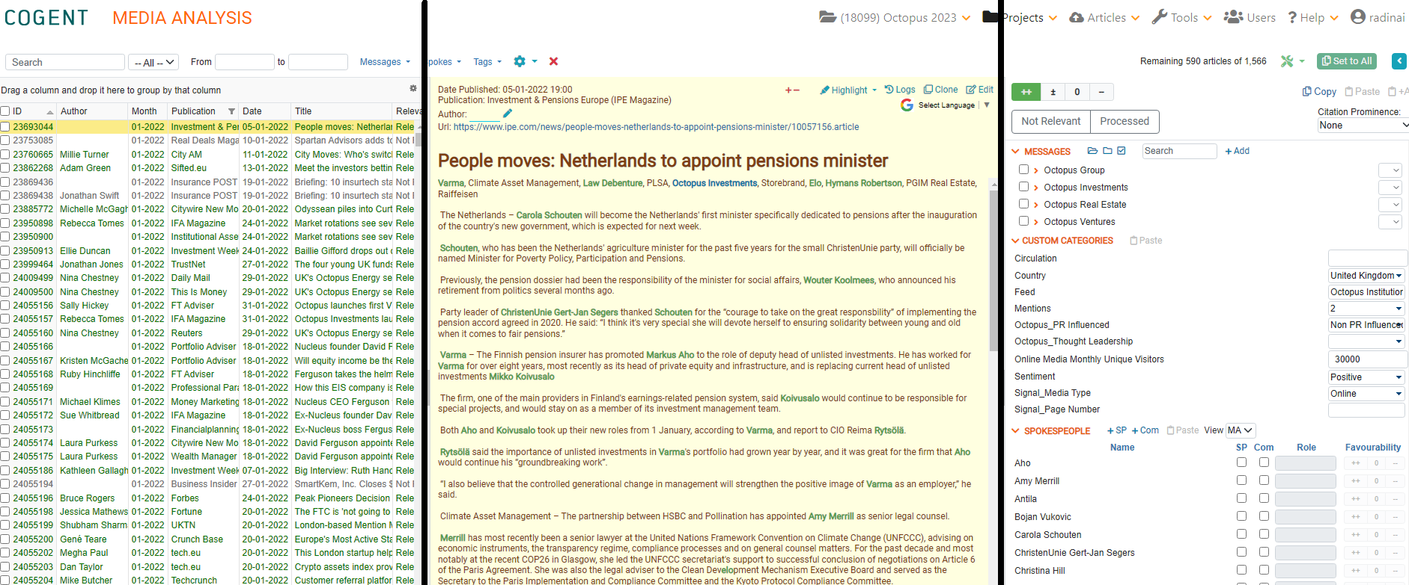
To open a project in the Media Analysis View, click on its name in the project list
The view consists of three sections: on the left is the list of all articles in the project; in the centre is the field with the content of the article itself, and on the right are the coding metrics that we assign to each article. The analysis is carried out via the third section of the MA view.
There are several words that all refer to “analysing” an article - “Coding”, “reading”, “processing” – you will get familiar with them all.

Slide 10
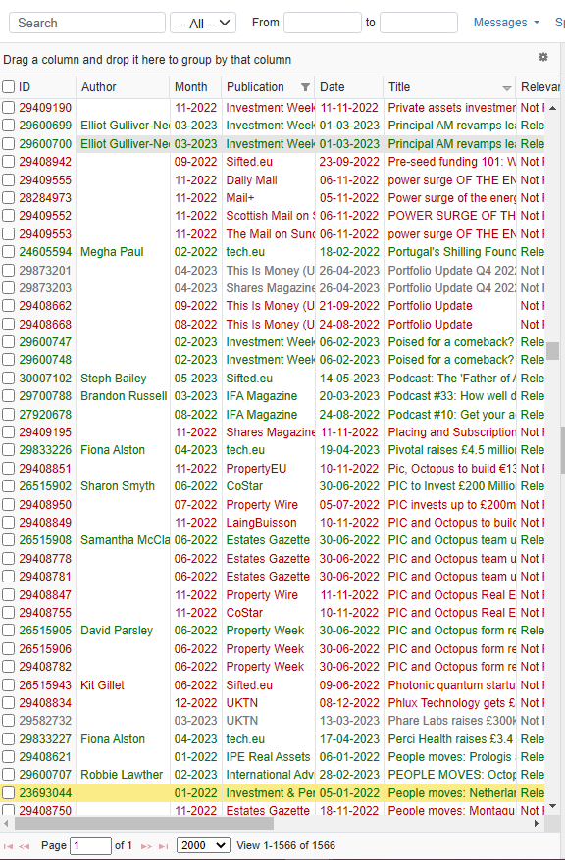
Left-hand side
Relevant / Irrelevant / Not Processed articles
You currently see a list of all articles in the project. This includes articles that have been analysed (they have been deemed relevant and are coloured in green), articles that are yet to be analysed (they are not processed and are coloured in red) and articles that are not of interest for that particular project but have sneaked in for one reason or another (articles that are irrelevant and are coloured in gray). You can use the drop-down menu next to the Search to filter your view of the articles.
[the drop-down menu also offers an option to filter by Processed – this is used for media monitoring so you can currently ignore it].
Search field
Date filter
Columns
Articles that are currently visible

Slide 11

Left-hand side II
Relevant / Irrelevant / Not Processed articles
Relevant here means that the article has been considered relevant/meaningful in the context of this particular project according to the relevancy requirements provided by the client. Relevancy criteria are specific for each project, and the project manager is in charge of communicating them to the team.
Not processed is the “raw” article that has not yet been analysed.
Not relevant: The article has been set to not relevant, meaning that it has been considered irrelevant to the subject of the analysis, i.e., the client. For example, the client is a company called Vienna Insurance Group, but the article mentions just Vienna as the city.
You can see how many articles are currently visible at the bottom left side of the screen.
This number depends on the filters you have applied. If you use the drop-down menu to select, let’s say, only the Relevant articles, the number at the bottom left side of the screen will correspond to the number of Relevant articles.
If the articles are too many, Cogent could split them into pages – If you want to see all articles, you can click on the drop-down menu at the bottom and select All.

Slide 12

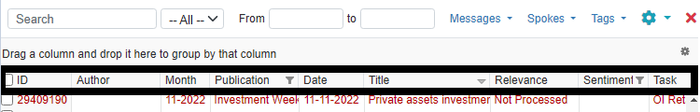
Left-hand side III
Date Filter
You can further filter the view of articles by applying a date filter. If you want to isolate only the Relevant articles for the month of April, you will select Relevant from the drop-down menu at the top and you will apply a date filter.
Columns
Each article has its own descriptors we refer to as metadata. Some of this data we receive automatically (for example the date and month of the article, the publication name, the headline), while others we fill in ourselves while analysing the coverage (for example Author name, Sentiment, Relevance). This data is situated in columns, similar to an Excel table.
Non-exhaustive visualisation of columns
We continue to explore these Columns on the next slide. Don’t forget that we are still focused on the left side of the screen.

Slide 13
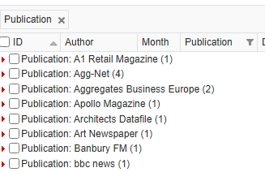
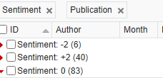
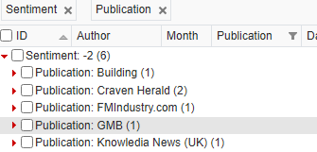
Left-hand side IV
Column actions
Clicking on a column name will sort the articles in ascending/descending order, chronologically, or alphabetically, depending on the column that you are sorting by (ID, date/time, title etc.). By default, the articles are sorted by ID in ascending order and by time and date in chronological order.
You can rearrange the columns according to your needs by using drag and drop.
You can also group articles by column. To do so, drag and drop a column in the field above the column names. You can group by as many columns as you want.
example of grouping by Sentiment and Publication. If you click on the 6 Negative articles, you can see the media sources that have published them
example of grouping by the Publication column

Slide 14

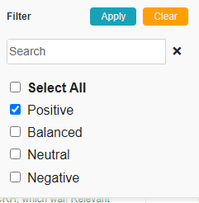
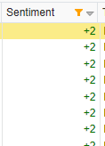
Left-hand side V
Column actions
Applying a filter to a column: You will notice that some of the columns have a filter option (little funnel next to the column name – see Publication, Sentiment). It is used to narrow down the displayed article list to your specific criteria.
For example, we may want to see a list only of the articles with positive Sentiment. To do this, click the filter of the Sentiment column and select Positive from the options, and click Apply. The little filter icon in the column will turn orange, thus indicating that this filter has been applied to the article list.
Be careful! The column filtering will remain in action until you remove it.
This marks the end of Column actions – for now.

Slide 15
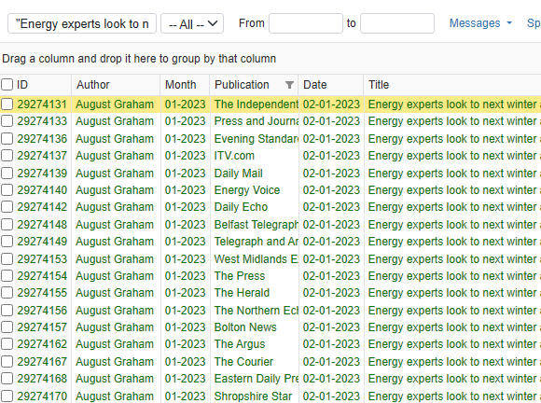
Left-hand side VI
Search
The Search works in a similar way to a Google search – you can look for mentions of a keyword or create more complex Boolean searches. The simplest search would be of a single keyword, with Cogent checking if the word is present in the headline or the body of the article. If you add an * sign after the word, Cogent will look for the word + any letters or characters after it. You can search for two words at the same time by using the operator AND. Once you run the search, Cogent will show you only the articles that adhere to the requirement. Searches do not affect all of the other filtering options, meaning you can use them in conjunction. Searches will not work if you don’t have the body of the article in Cogent.
The Search we carry out in Cogent is called an Article Body Search (or ABS for short).
You can also search for whole sentences if you add them in brackets (i.e. “Energy experts look to next winter as gas crisis is set to continue in 2023”). This is very useful in case of a batch (cluster) of articles – when an article has been reprinted (copied and reissued) in its entirety by several other publications, this creates a batch of articles. The content of all pieces is the same, meaning that the coding should be identical across the cluster. Using the search, you can isolate the articles and code them simultaneously using the Copy or Set to All function (please refer to Cogent Basics Part 2 for more information or ask your trainer).

Slide 16
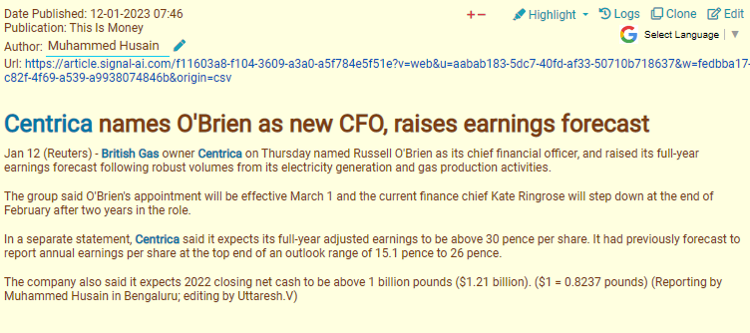
Centrefold
The article that is currently active is highlighted in yellow in the list of articles.
The butter yellow area in the center of the screen is the article body where all of its content is. Here, you can see the article’s content, date of publishing, publication, author, and URL, i.e., some of the metadata that is available as column names in the article list.
Translator
Edit button
Author field
Headline
Keyword
Body

Slide 17
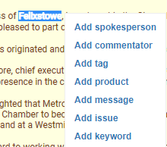


Centrefold II
The Author field is editable and you can manually add the name of the author that has written the article. When there is no author, we usually type NA.
Translation
On the top right of the article body, you can see the option for automated Google translation of the article’s content into English. The purpose of this functionality is to help you when working with a language that is foreign to you, as Commetric analyses media content in dozens of languages. Clicking it will display a list with all the languages available for translation.
Keywords
Keywords are words and word combinations specific to each individual project or project group, often including, for example, the client’s name, products/services, competitors’ names/products/services, certain events, types of technologies, and so on. In the text, they are highlighted in blue ‣
For example, a project with a focus on telecommunications might include keywords such as GSM, LTE, Internet of Things (IoT), WLAN, and many others.
You can add and remove keywords by clicking on the name of the project at the top of the screen, then selecting Project Settings ‣ Keywords. You can also add keywords by double-clicking on the word in the body and then selecting Add keyword (see pic above)

Slide 18
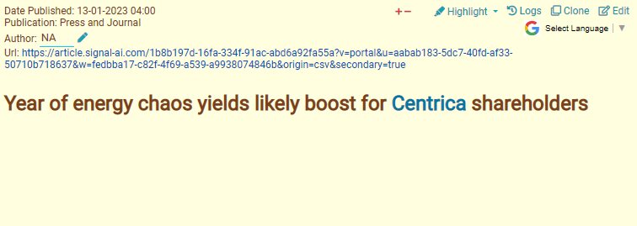
Centrefold III
Editing articles
Occasionally, some articles are uploaded into the project with an empty body. This is often the case with print media articles in PDF format, as it is a bit more complex for the system to ingest them.
There are two main reasons why it is more useful to have the article’s body on the platform: first, when we upload the article’s content, Cogent highlights certain project-specific keywords in it, which makes reading and skimming through the article a lot faster and easier. Second, this enables us to perform article body search and use the Boolean operators AND and OR to identify batches of articles more easily.
If you want to upload the content, you can do it manually as follows:
1. Click the Edit button on the top right.
2. This will take you to the Edit Article view where all of the metadata fields visible in the article body view are editable.
3. To upload the content of the article here, click on its URL.
4. Then copy the content and paste it into the Body field.
5. Tick the Run NLP box.
6. Click Update.
Article without a body

Slide 19
Centrefold IV
Entity mentions
Cogent’s NLP (Natural Language Processing) capability automatically detects entity mentions in the article body. Entities are the individuals featured in the article. Their names are highlighted in green (please refer to screenshot below). Entity detection is useful when establishing whether someone is a spokesperson or a commentator. If Cogent has not captured an individual’s name as an entity, you can add them manually by double-clicking on the name and then selecting Add spokesperson or Add commentator, depending on the case.
Do not worry if you don’t understand what a Spokesperson or a Commentator is – we will go through that in just a second when we explore the right-hand side of the screen with the coding metrics.

Slide 20
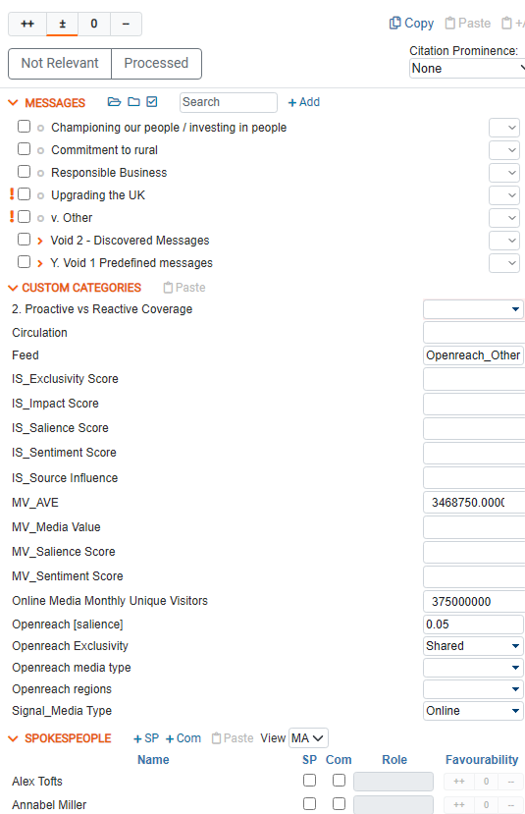
Right hand-side
In MA View, the right side of the screen is dedicated to the coding metrics that we assign to each article. The analysis is carried out via this section.
Sentiment coding
Relevancy coding
Message tree
Custom categories
Spokespeople & Commentators

Slide 21
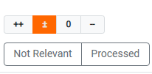
Right hand-side II
Sentiment analysis
The majority of projects use four-scale sentiment coding – Positive, Balanced, Neutral or Negative. This coding gives information as to how the client is perceived by the publication.
If the client is mentioned in a positive context, the article is considered Positive (the same goes for if the article is proactive, company-driven, with a spokesperson present). If the article is overtly critical towards the client, with no response from a spokesperson or redeeming statement, the article is Negative. If there are simultaneously positive and negative mentions of the client in the article, or if the client is criticised, but has responded/has apologized, the article is Balanced. Any passing, neutral mentions or factual information are tagged as Neutral.
Under the sentiment coding tableau, you can see the Not Relevant button which marks an article as not relevant.
Once you’ve established whether the coverage is Positive, Balanced, Neutral or Negative (or Not Relevant) and you click the respective button, the article is considered analysed and will change its colour from red to green in the list of articles (left-hand side of MA View). Most projects require the coding of other metrics in addition to sentiment coding, so I would suggest considering it as the last step of the coding process.
The colours you see throughout this slide correspond to the colours of the buttons on the sentiment analysis tableau. Regardless of your choice of sentiment coding, once analysed, the article will appear green in the list of articles.

Slide 22
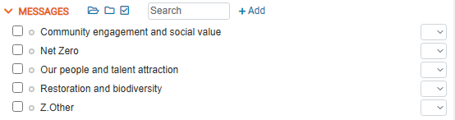
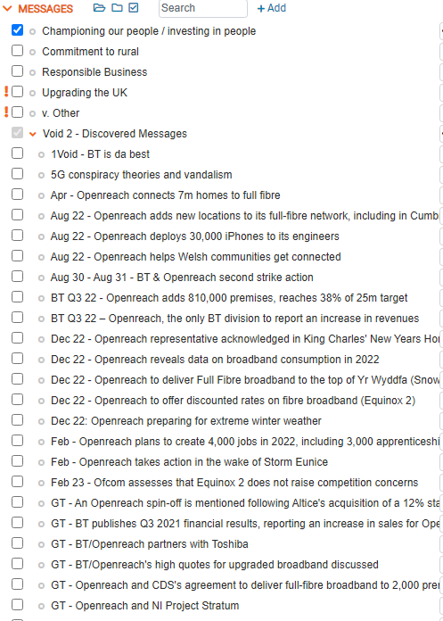
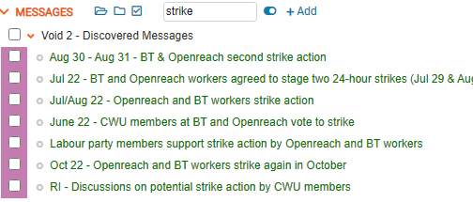
Right hand-side III
Message tree
The message tree is employed in the most complex and time-consuming part of the analysis – the message coding. On the basis of this coding, we can establish the main focus of reporting, thus helping the client understand how it is presented in the media.
Each message tree is unique and is created with the client’s objectives in mind. Please, keep in mind that not all trees have the same elements thus the coding process could differ from project to project.
Messages are coded by clicking their respective check-box.
Examples of a very simple and a more complex message tree
The messages panel has its own Search function which can help you find particular messages that contain a keyword. Once you’ve run your search, you can click on a button that enables you to see only the messages containing the keyword.

Slide 23
Right hand-side IV
Message tree
The message tree is constituted of the main topical drivers of coverage as well as the messages the client wants to convey with its media presence. Some clients want to be perceived as leaders in industry debates, while others are focused on their image as a good employer. More often than not, how the client is actually perceived is completely different from how they want to be perceived.
This is why we have different types of messages we can tag in an article:
Predefined messages – provided by the client, usually vague and PR-sounding (“Our people and talent attraction”; “We are a responsible supplier who has been around a long time”).
Discovered messages – discovered by the analyst, usually client-focused & client-specific (“Centrica appoints Russell O’Brien as CFO”; “Centrica re-opens Rough gas storage facility”)
In stark difference to most other metrics, one article can have more than one message. This has a significant effect on how messages are exported via Pivot.
This is very much so just scratching the surface when it comes to messaging and the types of messages we have – they could be visualised as Topics and sub-topics or described as “reputational dimensions” or “key messages”. As previously mentioned, this is all project-specific so it will be explored in detail when you start analysing.

Slide 24
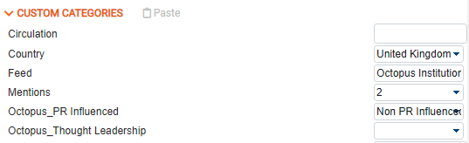
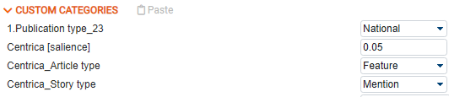
Right hand-side V
Custom categories
The Custom categories (or CCs) are additional metrics we are tracking in the media coverage. The key word here is the word “custom” – these metrics entirely depend on the client’s needs and are established on a project-to-project basis. Some of the more popular custom categories are Country, Media Type (Online vs Print vs Blog vs Broadcast), Proactive vs. Reactive.
Examples of different types of CCs
CCs are similar to metrics such as Sentiment or Publication because they can only have one value – the article is either Proactive or Reactive but it definitely cannot be both at the same time. Meanwhile, messages and spokesperson & commentators can have more than one value i.e. one article can contain several messages, one article can have several commentators present.

Slide 25
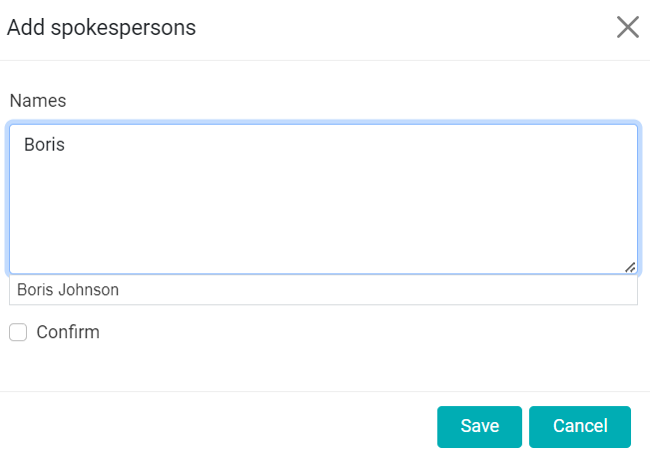
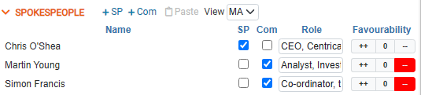
Right hand-side VI
Spokespeople & Commentators
This is where we tag any spokespeople or commentators present in the article. A spokesperson is a company representative that has been quoted in the piece. A commentator is a third-party representative that has issued a statement in relation to the client. A mere mention does not equal a spokesperson/commentator quote – the person should be featured with a statement in order for them to qualify as a spokesperson/commentator.
Thanks to the NLP function, Cogent gives suggestions for people’s names i.e., all people coloured in green in the article body should appear under the Spokespeople coding menu as suggestions. This does not mean they are spokespeople or commentators but it’s worth checking if they are. If you want to add a name that is not present as suggestion, you can do so by clicking on the +SP or +Com button.
The menu is titled SPOKESPEOPLE, but it features both spokespeople & commentators coding

Slide 26
Right hand-side VII
Spokespeople & Commentators II
Spokespeople & Commentators have their own roles which are basically their business occupation. If the person has already been tagged as a spokes or comms in the Cogent environment, regardless if this has happened in this or any other project, the role will be filled in automatically. If not, you have to add it manually.
The only difference between Spokesperson and Commentator coding is that commentators have their own sentiment. This favourability is different from the overall sentiment coding of the article and refers to that individual’s own thoughts and opinions on the client. Commentator sentiment is coded on the Spokepeople Favourability tableau (please see pic above) and is three-scale – Positive; Neutral (which often includes Balanced comments) and Negative.
That’s all when it comes to the basic of the basics! That said, Cogent is huge so stay tuned for Cogent basics part II ☺

